Slide 1
Welcome to Pitch Perfect!
An Introduction To
Public Speaking. Level One.
Notes:
What you will need:
Printed copies (one per student) of the Pitch Passport.
Students should already know / have their username and password. They can write this in their Pitch Passport.
An internet connection that allows access to youtube

Slide 2
Definition
Of Public
Speaking
“the act or process of making speeches in public”
A good speech should have one of these goals…
To Influence
To Educate
To Entertain
Notes:
5 minutes
Definition of public speaking.
Explain each one and give examples:
To influence – a speaker may need to influence the audience. This means they are trying to convince the audience about a certain topic. It could even be a sales person trying to explain the benefits of a product to a customer or it could be a politician trying to convince people to vote for him or her. Can you think of a type of speaker that would need to influence the audience?
To educate – who needs to educate their audience? A teacher, or a football coach or a university professor
To entertain – what type of speaker needs to entertain their audience? A comedian, a TV show presenter. Can you think of anyone else?

Slide 3
Pitch Perfect is all about public speaking
What is public speaking?
How can public speaking help you?
Who needs to be good at public speaking?

Slide 4
Activity
With a partner discuss:
What do you think public speaking is
Who needs to be good at public speaking & why
Notes:
5 Minutes. Retrieval and discussion:
Students pair up and discuss the questions on the slide. (Use breakout rooms or equivalent if doing this online.)
LO: Can students tell you what public speaking means (definition) and how it relates to their success (context and personalization) and how it relates to other successful people they may know about or have heard of (wider context)?
Can students name any people or professions that require you to be a good public speaker?

Slide 5
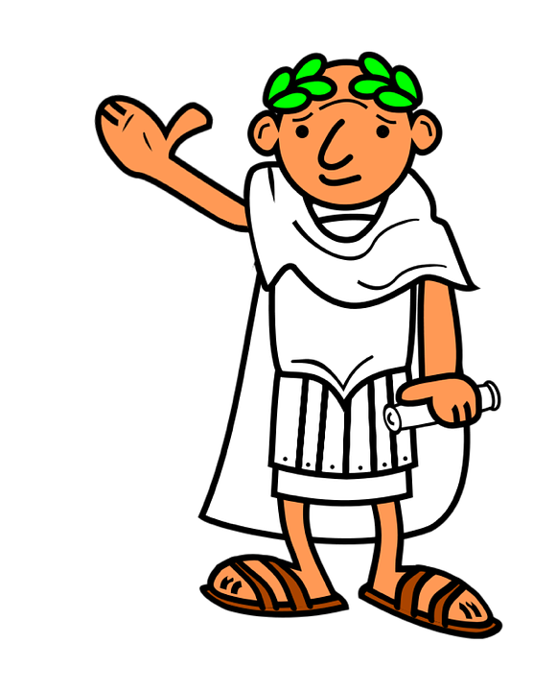
A History of Public Speaking
Modern public speaking methods can be traced back to Ancient Greece and Rome
Some methods are still studied and used today
Notes:
What is the history of public speaking? And why is public speaking important?
There's a good chance that there's been public speech, in one form or another, as long as there've been people. But most public speaking experts involved with public speaking in business communication, trace the origins of modern public speaking back to ancient Greece and Rome.
They developed public speaking methods that are still studied today.

Slide 6
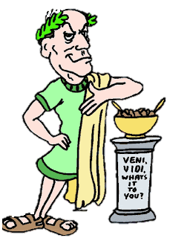
Order!
Order!
The Romans used public speaking in senate debates
Notes:
What is the history of public speaking? And why is public speaking important?
There's a good chance that there's been public speech, in one form or another, as long as there've been people. But most public speaking experts involved with public speaking in business communication, trace the origins of modern public speaking back to ancient Greece and Rome.
They developed public speaking methods that are still studied today.

Slide 7
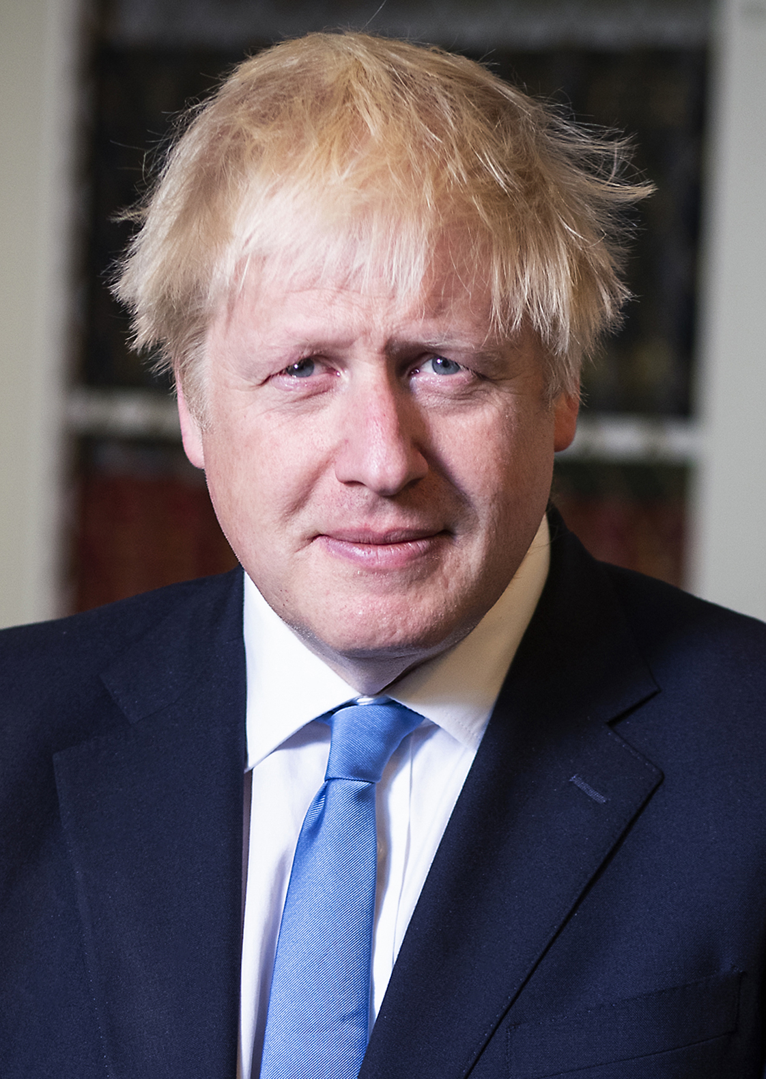
Examples of good public speakers…
Boris Johnson, UK Prime Minister
Notes:
Some examples of successful public speakers.
Ask students:
Why do these people need to be good at public speaking?

Slide 8
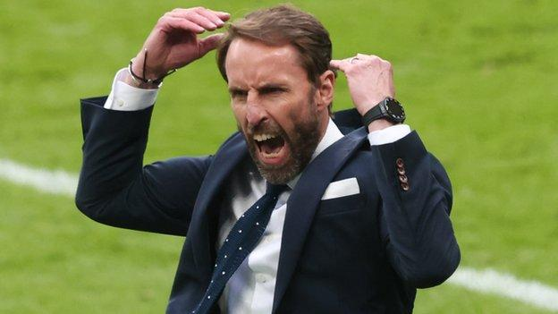
Examples of good public speakers…
Gareth Southgate, England Football Team Manager
Notes:
Some examples of successful public speakers.
Ask students:
Why do these people need to be good at public speaking?

Slide 9
Examples of good public speakers…
DANTDM – Youtuber / Gamer
Notes:
Some examples of successful public speakers.
Ask students:
Why do these people need to be good at public speaking?

Slide 10
More examples…
TV Presenter
Sports Person
Teacher
Leader
Business Person
Notes:
More examples of the different types of professions that require you to be good at public speaking

Slide 11
Let’s see an example of a good public speech
Notes:
5 minutes. Watch the video
LO: Find out what makes a good speech Some highlights of First Lady, Michelle Obama addressing a graduation ceremony.
Questions to ask students after they watched the video….
Ask: What makes this speech good? Ask: Why do the audience cheer? Ask: Can you hear any changes in the voice of the speaker (pitch, pace, pause)?

Slide 12
It’s Game Time!
It’s your chance to pretend to be
a famous celebrity!
Sports Star & Interviewer
Teacher & Student
Business Person & Customer
Youtuber & Interviewer
Notes:
20 minutes: Game time! Role Play and Speaking Activity: Pair students up. They can choose to be one or the other from the list or even choose their own. One student will ask questions (interviewer) and the other will present their answers (interviewee). Swap role plays after 2 minutes.
After both have had a go at each role play, change partners and present to someone different. Give students lots of opportunities to talk and pretend to be all of the roles plays if time allows.

Slide 13
You Will Earn Badges, Points and Ranks!
Notes:
5 minutes
Explain the badge, points and ranking system to your students. This added gamification is a great way to encourage your students to engage even more with your teaching!
You can login to your account on the portal at www.youngleadersacademy.co.uk/login and show students around the My Account page where they will see all the badges.
on their online portal, students will earn points After completing tasks like watching a video, taking a quiz, getting top marks in a quiz.
They can exchange their points for ranks. Everyone starts as an assistant and can work their way up to CEO!
After completing a module, students automatically earn one of the badges above
Show students how to access their course and give an example of how to complete a module

Slide 14
Module 7: Analysis & Reflection
Module 8: The Masterpiece
Your Route To Success
Module 5: Using Your Voice & Body
Module 6: Your 1st Speech
You are one step from successfully completing Module 1. You can now earn points.
Module 4: Planning & Preparing A Presentation
Module 3: One Minute Word Challenge
Module 2: Just Standing Up
Simply login online, complete Module 1 and you will earn points!
Module 1: What Is Pitch Perfect?
YOU ARE HERE!

Slide 15
Access your account on the Young Leaders Academy website. Remember to upload work to the relevant place 1. Login 2. Watch the ‘What Is Pitch Perfect’ video 3. Complete the quiz & upload your work 4. Earn badges, points and ranks for completing tasks
Home / Extra Activity:
You will earn
badges like this
Notes:
Home / Extra Activity Make sure each student has their login details outlined on their Pitch Passport. They should have a ‘username’ and a ‘password’ To login, students go to www.youngleadersacademy.co.uk/login
Encourage students with points
eg first one to login will get an extra 100 points.
Top of the quiz leader board will get an extra 100 points.
Fastest quiz time will get an extra 100 points too.

